Slide 1


NEXT GEN EMPLOYABILITY PROGRAM
CREATING A FUTURE-READY WORKFORCE
Student Name :
Vaishnavi M S
AICTE Internship Student Registration ID *
STU67b5ebd3ce9811739975635
AICTE Internship ID
College Name :
ADICHUNCHANAGIRI INSTITUTE OF TECHNOLOGY
INTERNSHIP_173951615267aee8f889303

Slide 2
CAPSTONE PROJECT SHOWCASE
Project Title
A Service for Delivering Food (Zomato Clone) with MERN Technology
Abstract | Problem Statement | Project Overview | Proposed Solution | Technology Used | Modelling & Results | Conclusion | Q&A

Slide 3
Abstract
1
Online food delivery apps like Zomato set high standards in UI/UX, real-time updates, and responsiveness..
2
Building such platforms involves managing complex frontend components and dynamic backend data flow
3
EatzNow, built with the MERN Stack, offers a simplified yet scalable food ordering experience with real-time restaurant listings and a responsive, user-friendly interface.

Slide 4


Problem Statement
Creating a modern, responsive, and interactive food delivery platform presents challenges in managing dynamic data, seamless routing, and real-time filtering of restaurant menus. Traditional static implementations fail to offer scalable, modular design and lack backend support. This project addresses the need for a full-stack solution with real-time capabilities and modern UI/UX, inspired by Zomato.

Slide 5

Project Overview
EatzNow is a full-stack food ordering web application that replicates core functionalities of Zomato, such as:
Real-time browsing of restaurants and menus
Dynamic filtering and search options
User-friendly interface and responsive layout
MongoDB-based storage for restaurants, dishes, and user data

Slide 6
Proposed Solution
Frontend (React.js + JSX): Responsive UI with reusable components, search filters, and animations.
Backend (Node.js + Express): REST APIs to manage restaurants, dishes, and user data.
Database (MongoDB Atlas): Cloud-hosted database storing all backend information.
Routing (React Router): Seamless navigation between pages like Home, Search, and Restaurant details.

Slide 7
Technology used
Frontend: React.js, JSX, Tailwind CSS / CSS3
Backend: Node.js, Express.js
Database: MongoDB Atlas
Tools: Postman (API testing), GitHub, VS Code

Slide 8
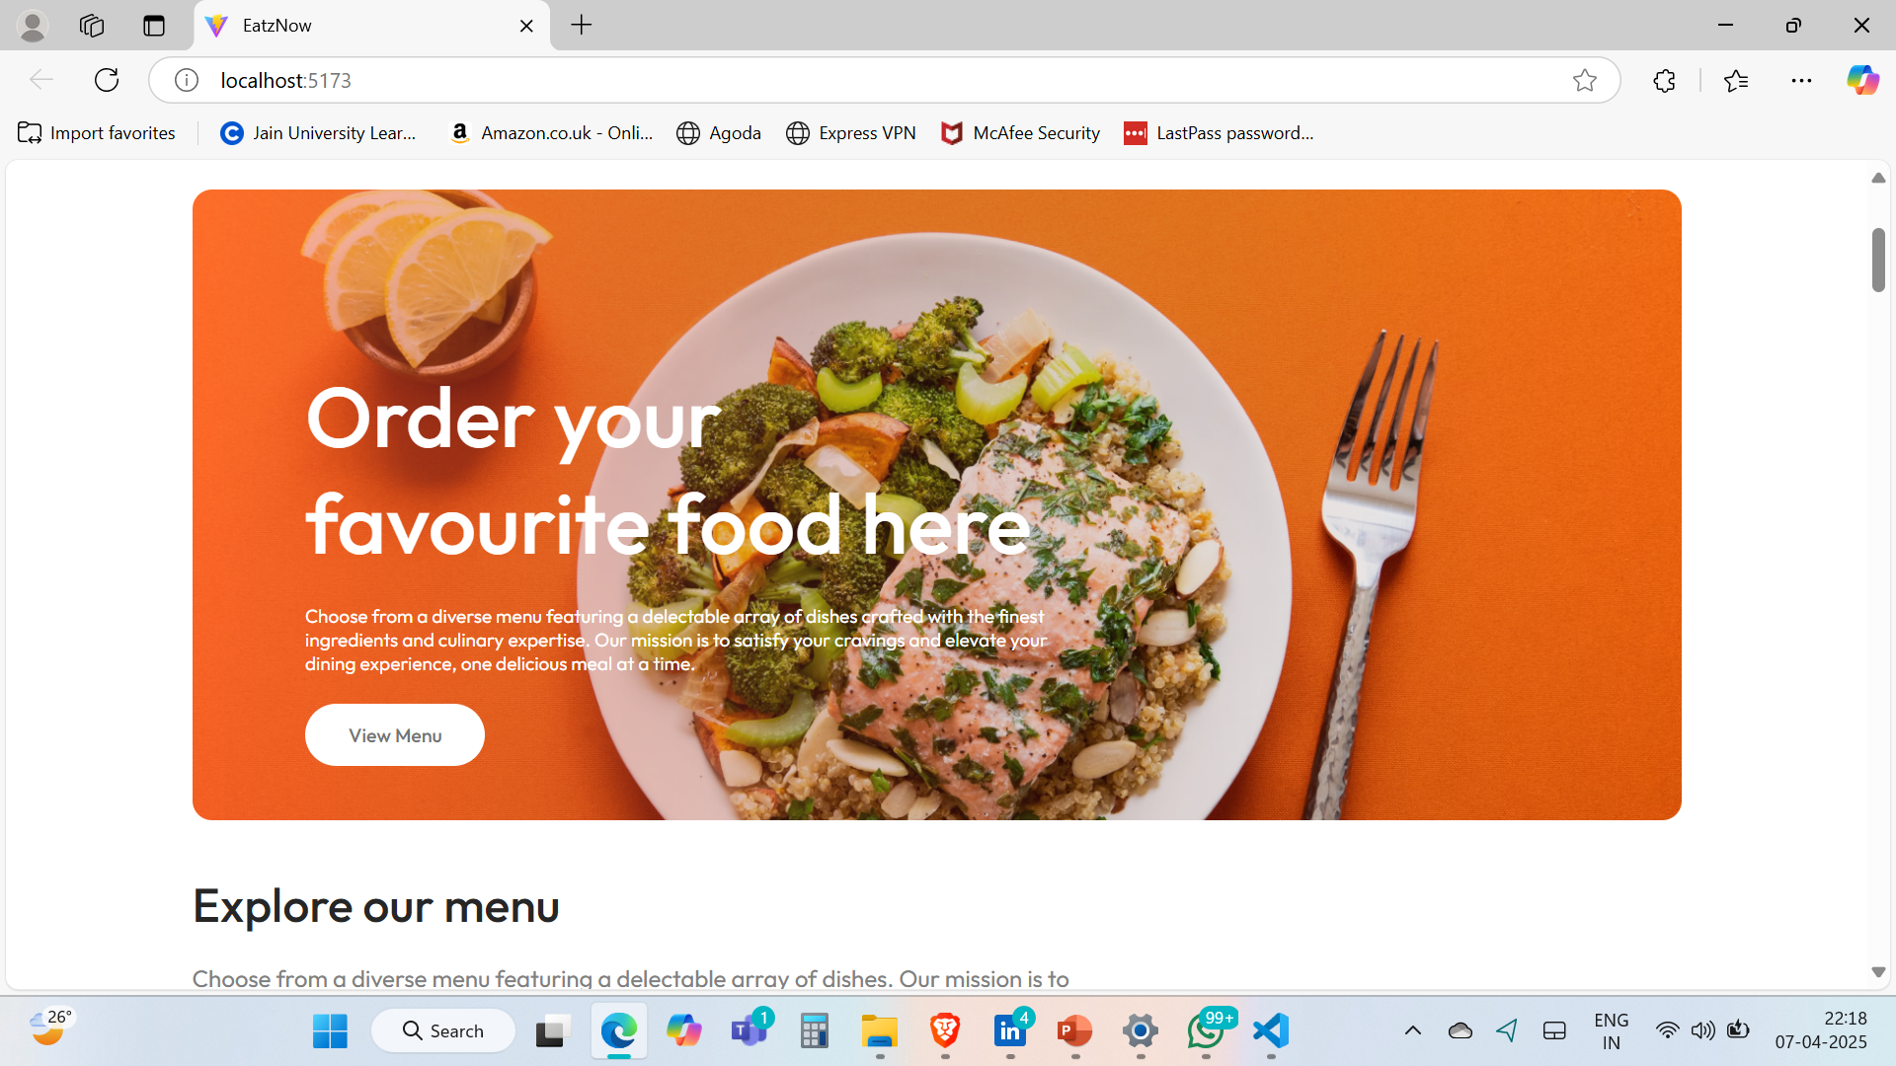
Modelling & Result
Dynamic Restaurant & Menu Management: Fully implemented CRUD operations using MongoDB and Express.js, allowing seamless creation, editing, and deletion of restaurant and menu data — ensuring real-time updates across the platform.

Slide 9
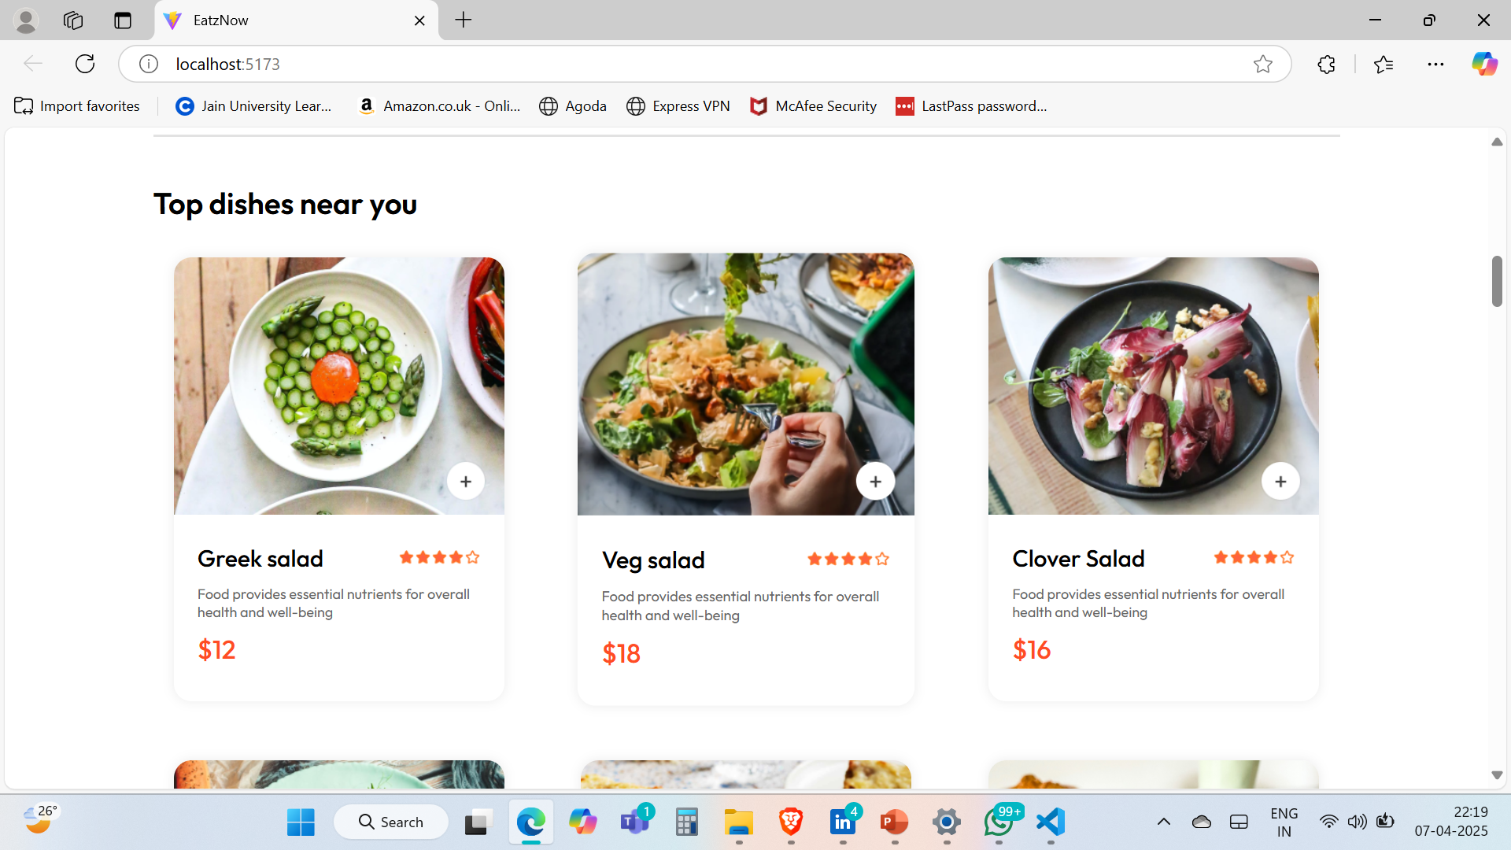
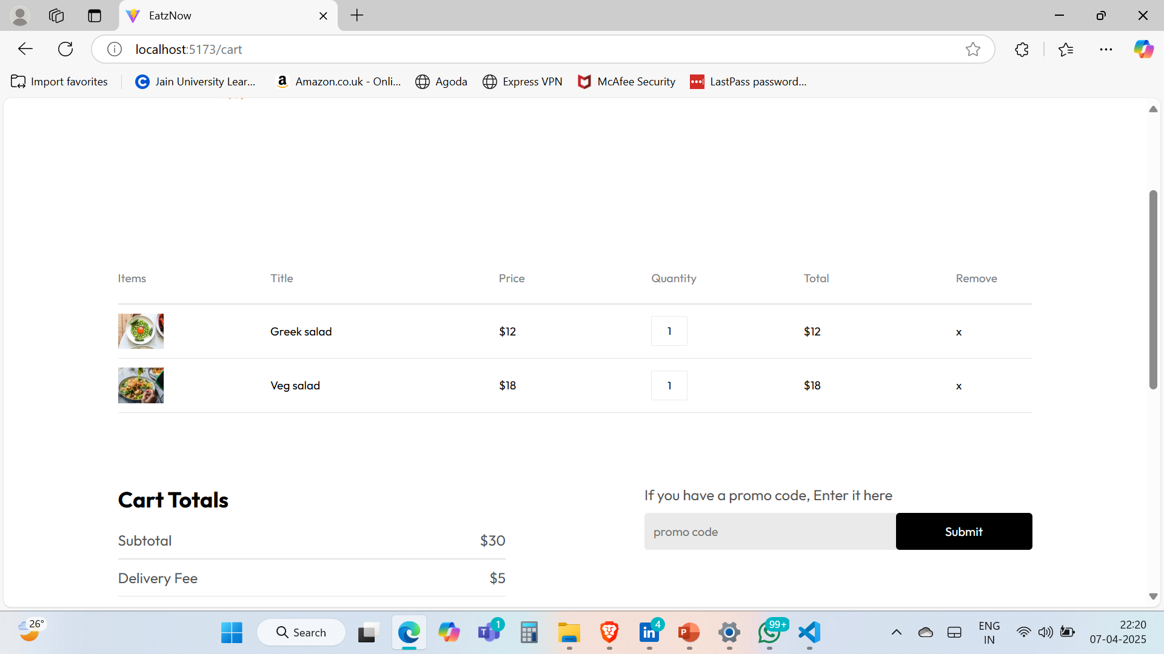
Modelling & Result
Scalable & Responsive UI/UX: Built with modular React components and responsive grid layouts, the app delivers a smooth, device-friendly user experience with real-time search and filtering by name, category, and rating.

Slide 10
Deployment Link: https://eatz-now.netlify.app/

Slide 11

Conclusion
EatzNow is a full-stack food delivery web application inspired by Zomato, built using the MERN stack (MongoDB, Express.js, React.js, Node.js). It features real-time restaurant listings, intuitive menu navigation, and responsive design for seamless user experiences across devices. The frontend uses React for dynamic UI rendering and routing, while the backend, powered by Express and Node.js, handles RESTful APIs and database communication. MongoDB Atlas stores restaurant and menu data securely. EatzNow supports real-time search, category filtering, and CRUD operations. This project demonstrates strong full-stack development skills and serves as a scalable prototype for modern food delivery platforms.

Slide 12


Notes:
Thank You !!

